Slide 1

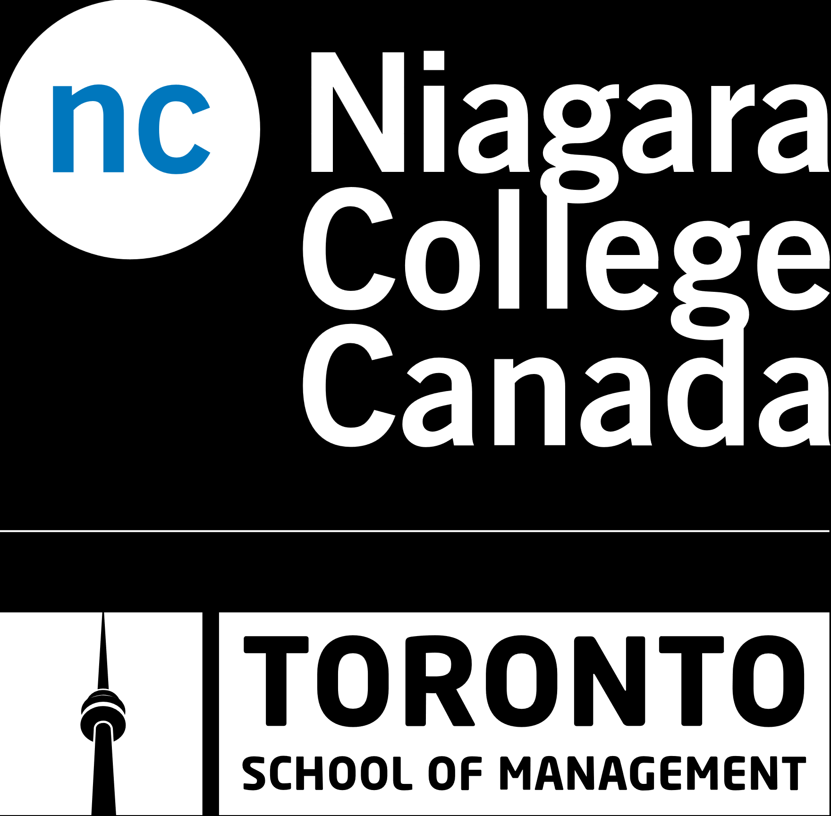
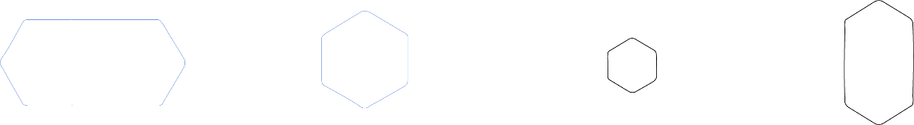
Course title :Mobile and Windows Store Development
Code :PROG1442
Instructor's name :
Session Number : 4
Date :
Spring 2024
niagaracollegetoronto.ca

Slide 2

Week | Topic | Assessments and Activities | Learning Objectives
Week 3 | Understanding XAML and UI Design • This week introduces the Extensible Application Markup Language (XAML), essential for creating user interfaces in mobile and Windows Store applications. Basics of XAML, layout, and navigation in mobile development. | Lecture and Discussion In-Class Individual Activity. | Objective 2: Design and create UI using Extensible Application Markup Language (XAML). 2.1: Introduction to layout and navigation using XAML in mobile development. 2.2: Discuss Attribute Element syntax and Property Element syntax.
RECAP

Slide 3
Week | Topic | Assessments and Activities | Learning Objectives
Week 4 | XAML and UI Design Continued • Building on the XAML introduction, this week delves deeper into XAML concepts. • Attribute Element syntax and Property Element syntax for more advanced UI design. | Lecture and Discussions Test 2: 10 %. | Objective 2: Design and create UI using Extensible Application Markup Language (XAML). 2.3: Explore the Visual Tree for controlling XAML objects. 2.4: Demonstrate data binding using the {Binding} markup extension. 2.5: Explain the creation of XAML App Resources.
AGENDA

Slide 4

Objective 2: Design and create UI using Extensible Application Markup Language (XAML).

Slide 5
1. Defining Layouts and Navigation using XAML in Mobile development:
Steps:
Open Visual Studio 2022.
Create a new Xamarin.Forms project (e.g., Xamarin.Forms App).
In the Solution Explorer, navigate to the App.xaml file.
Modify the App.xaml file to define the application-wide resources, styles, and themes.
Create XAML pages for each screen of your application (e.g., MainPage.xaml, SecondPage.xaml).
Define the layouts for each page using XAML elements such as StackLayout, Grid, etc.
Implement navigation between pages using Xamarin.Forms navigation methods (e.g., Navigation.PushAsync, Navigation.PopAsync).
https://learn.microsoft.com/en-us/xamarin/get-started/first-app/?pivots=windows-vs2022

Slide 6
https://devopedia.org/xamarin-forms
2. Compare and contrast Attribute Element syntax and Property Element syntax:
Attribute Element Syntax:
Uses attributes to define properties directly within the opening tag of the XAML element.
Example:
xmlCopy code
<Label Text="Hello, World!" FontSize="20" />
Property Element Syntax:
Uses nested elements to define properties.
Example:
xmlCopy code
<Label> <Label.Text>Hello, World!</Label.Text> <Label.FontSize>20</Label.FontSize> </Label>

Slide 7
3. Utilize the Visual Tree to control how XAML objects are positioned and how they respond to user-initiated events:
Steps:
Use layout containers like StackLayout, Grid, etc., to organize XAML elements.
Utilize attached properties and event handlers to control positioning and responsiveness to user-initiated events.
Use XAML debugging tools in Visual Studio to inspect the visual tree and identify layout issues.

Slide 8
4. Demonstrate data binding to XAML elements using the {Binding} markup extension to establish a data binding reference in XAML:
Steps:
Define a data model class (e.g., ViewModel) with properties that you want to bind to.
Set the DataContext of your XAML page to an instance of the ViewModel.
Use the {Binding} markup extension to bind properties of XAML elements to properties of the ViewModel.
Ensure that PropertyChanged events are raised in the ViewModel when property values change.

Slide 9
5. Define and create XAML App Resources to improve maintainability and localization:
Steps:
Define application-wide resources such as styles, brushes, templates, etc., in the App.xaml file.
Use the x:Static markup extension to reference static resources defined in code-behind or other classes.
Utilize the x:Key attribute to give a unique identifier to each resource.
To support localization, create resource files for each language (e.g., AppResources.resx for default, AppResources.fr.resx for French).
Use resource keys in XAML elements and use Xamarin.Forms localization APIs to load the appropriate resource file based on the device's language settings.

Slide 10
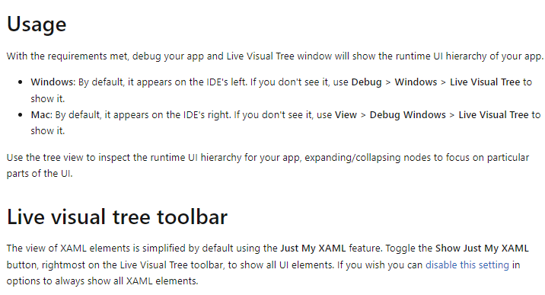
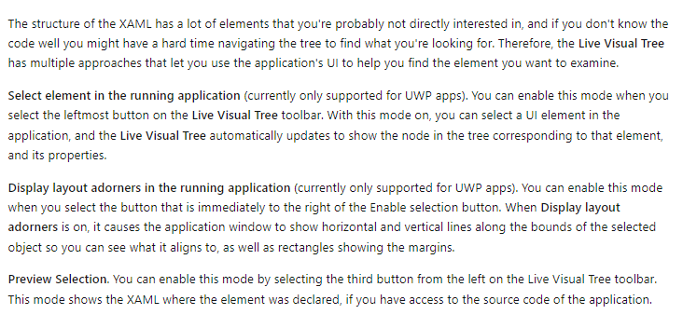
Exploring the Visual Tree
Visual Tree: Learn about the Visual Tree and how it is used to control the structure and hierarchy of XAML objects.
Visual Representation: We'll provide visual representations to help you grasp the concept.
https://learn.microsoft.com/en-us/xamarin/xamarin-forms/xaml/live-visual-tree

Slide 11
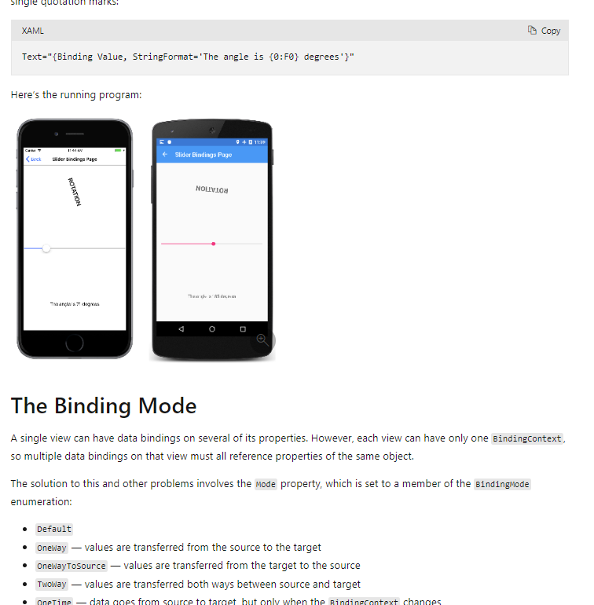
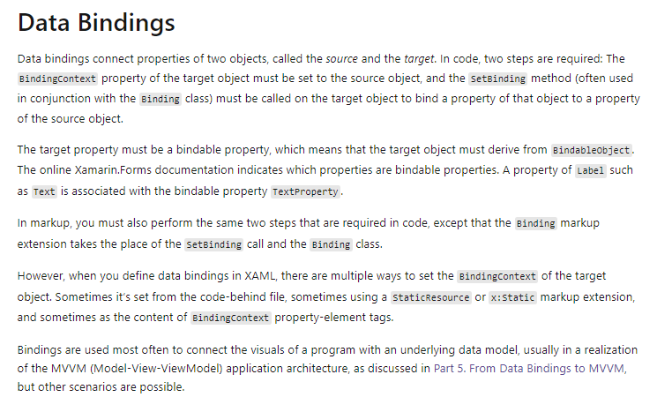
Data Binding in XAML (Objective 2: 2.4)
Data Binding: Discover how data binding using the {Binding} markup extension can connect data to your user interface.
Practical Application: See how data binding enhances the user experience in your applications.
https://learn.microsoft.com/en-us/xamarin/xamarin-forms/xaml/xaml-basics/data-binding-basics

Slide 12
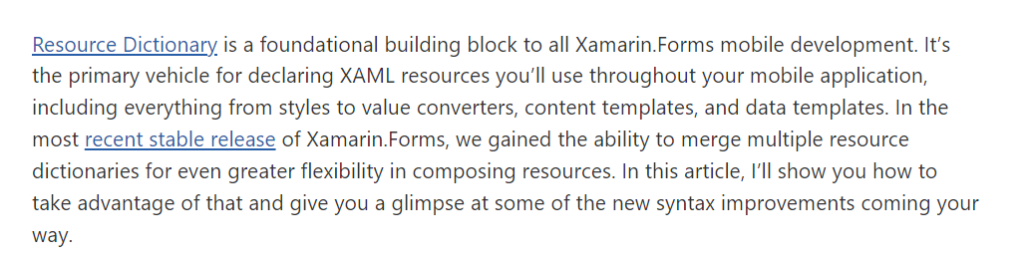
Creating XAML App Resources
App Resources: Understand how to create XAML App Resources to define and share resources across your application.
Efficiency and Consistency: Learn how App Resources can help you maintain design consistency and resource efficiency.
https://devblogs.microsoft.com/xamarin/better-resource-organization-xamarin-forms/

Slide 13
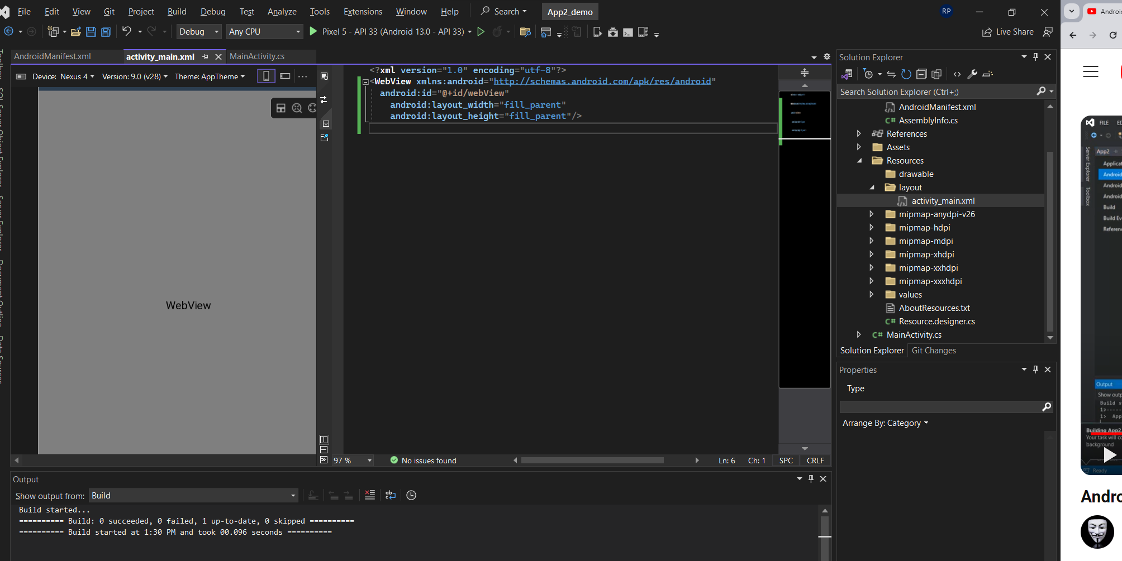

Slide 14
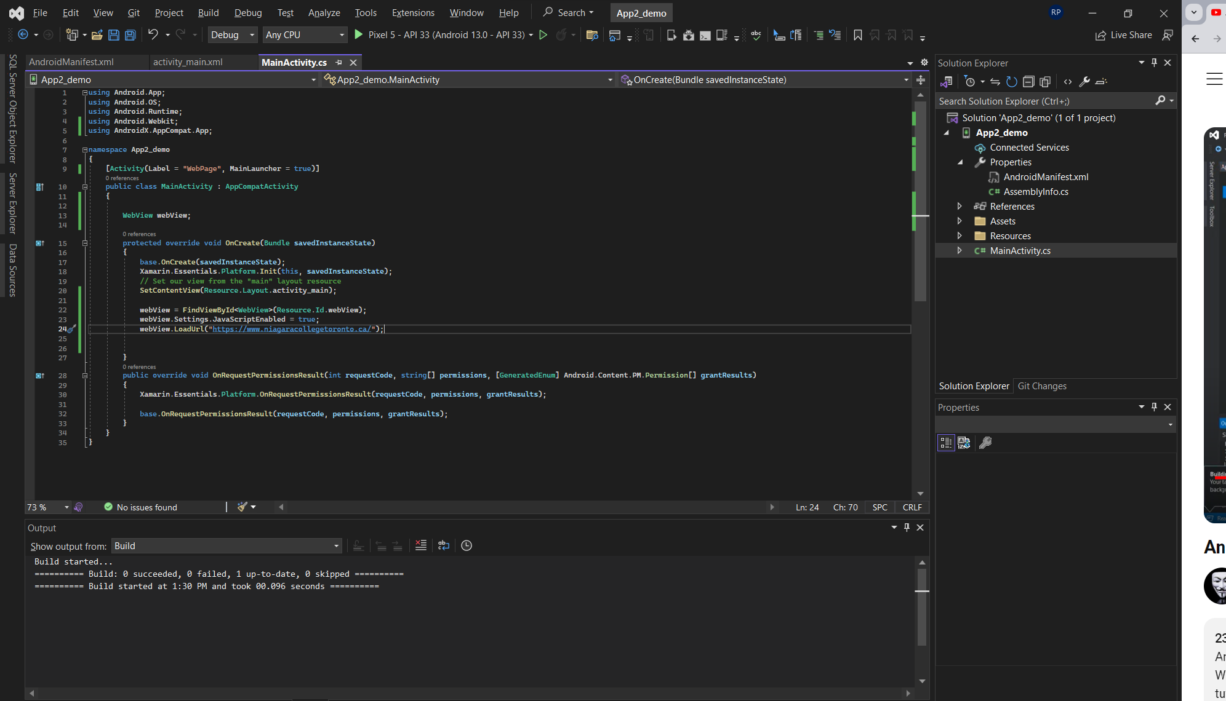

Slide 15
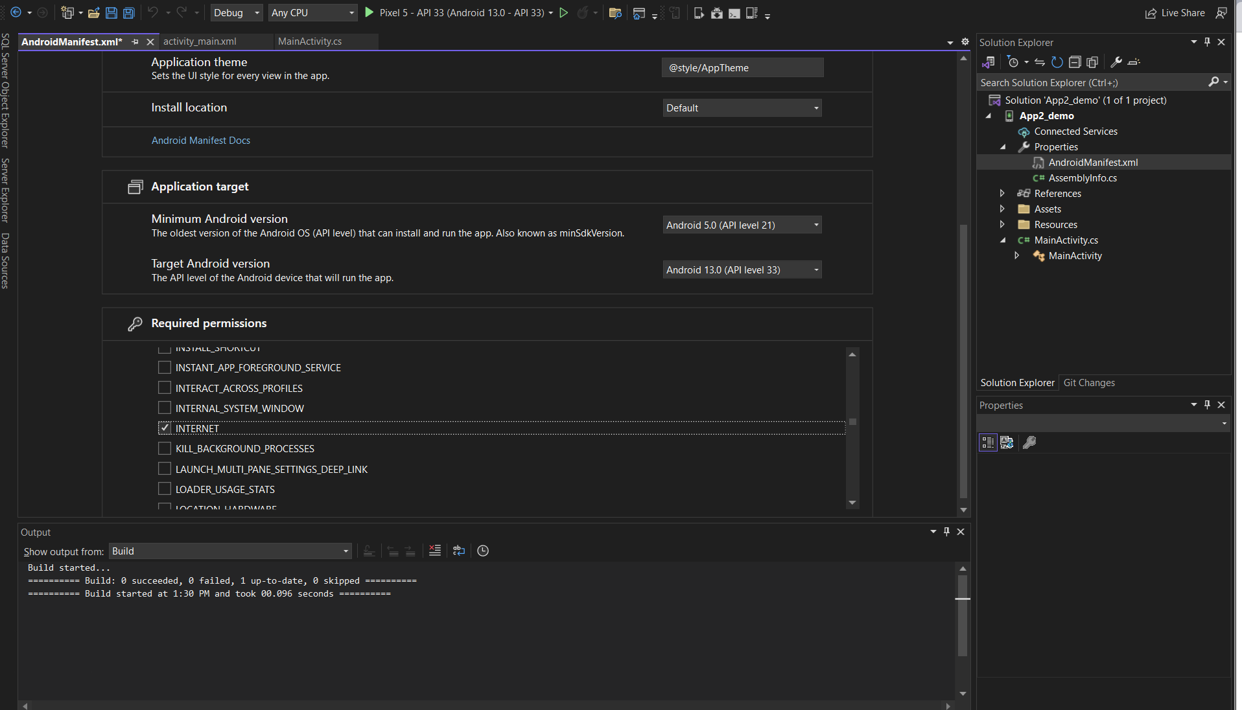

Slide 16
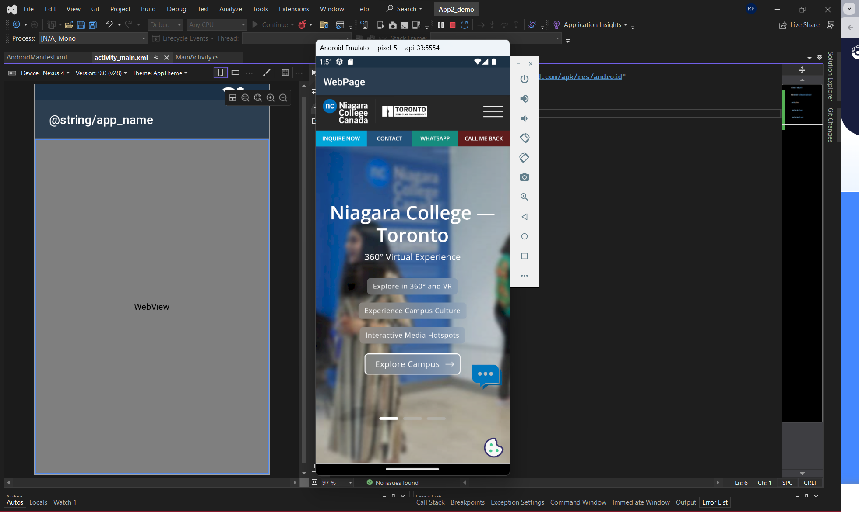

Slide 17
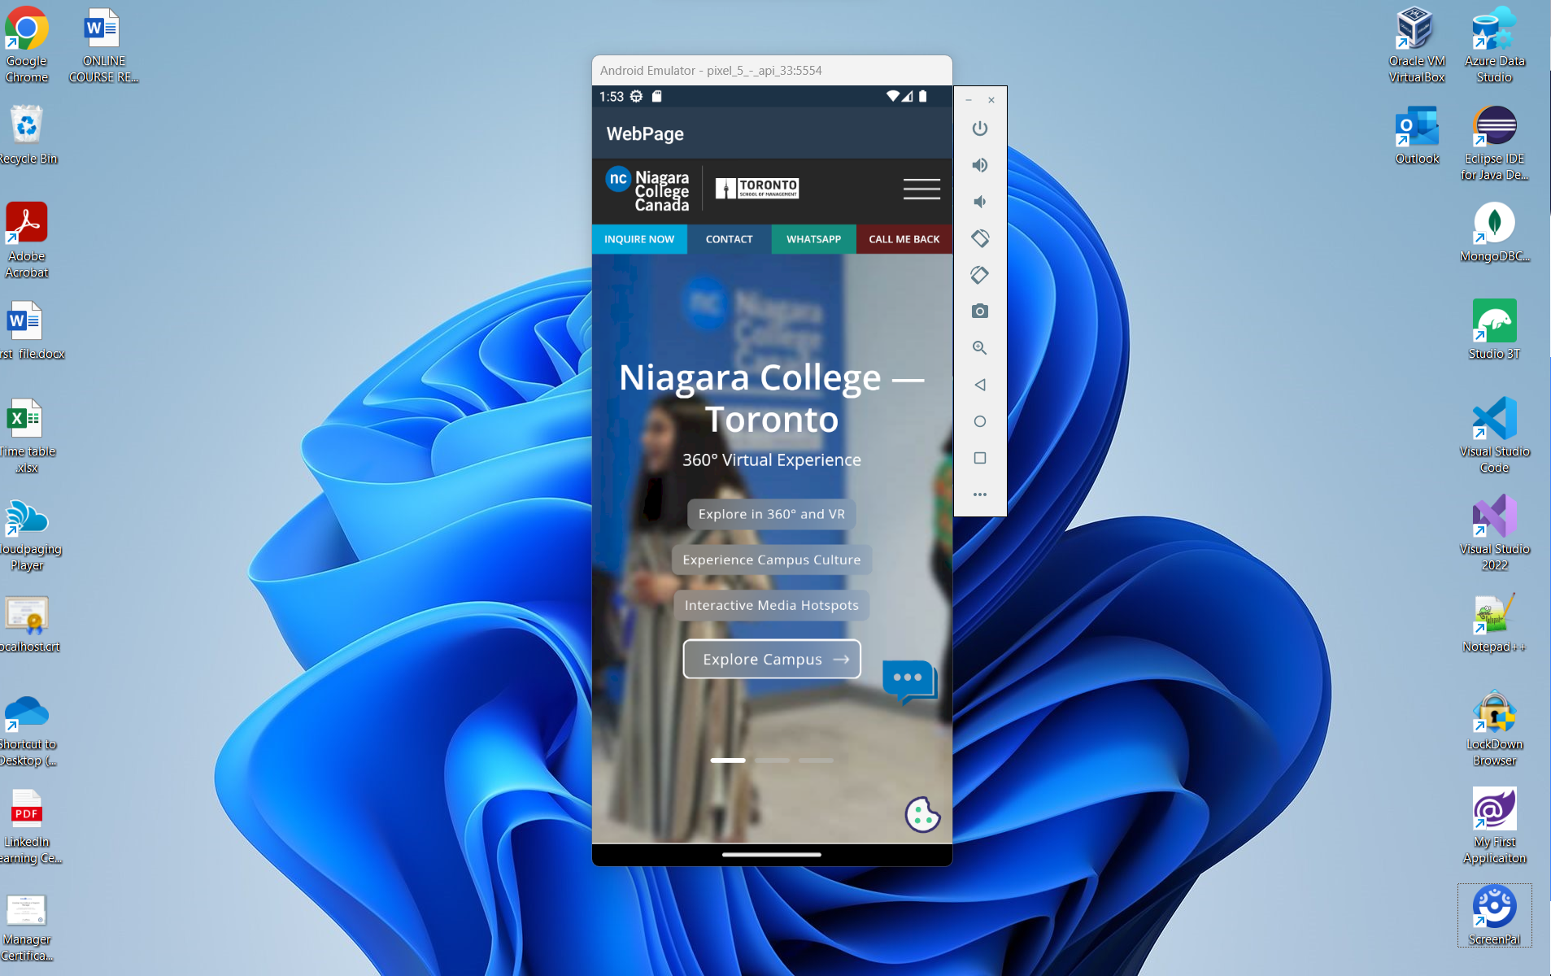

Slide 18
https://learn.microsoft.com/en-us/xamarin/Links to an external site.
https://learn.microsoft.com/en-us/xamarin/get-started/quickstarts/database?pivots=windowsLinks to an external site.

Slide 19
Week 4
Objective 2
Learning the basics of XAML for UI design.
Creating layouts and navigation structures.
Practicing Attribute and Property Element syntax.
Understanding the Visual Tree and data binding.
Creating XAML App Resources for improved maintenance.

Slide 20
Test 2 (10 %)

Slide 21
Week | Topic
Week 4 | Objective 2: Design and create UI using Extensible Application Markup Language (XAML). 2.3: Explore the Visual Tree for controlling XAML objects. 2.4: Demonstrate data binding using the {Binding} markup extension. 2.5: Explain the creation of XAML App Resources.
SUMMERY

Slide 22

Any Questions

Slide 23
NEXT
Week | Topic | Assessments and Activities | Learning Objectives
Week 5 | Implementing the MVVM Design Pattern • This week introduces the Model-View-View Model (MVVM) design pattern, a • The MVVM architecture and its benefits regarding separation of concerns and maintainability. | Lecture and Discussions Project 1 issued with an explanation. | Objective 3: Implement the Model-View-View Model (MVVM) design pattern for data-connected applications. crucial concept for building data-connected applications. 3.1: Describe occasionally connected programming and database access. 3.2: Introduce MVVM application frameworks for attribute-based page and view model discovery.

